Slide 1

R L C series and parallel

Slide 2
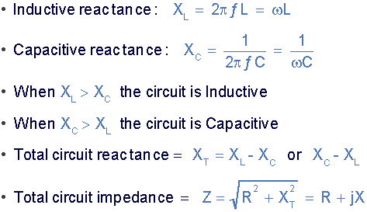


Slide 3
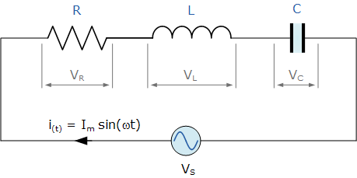
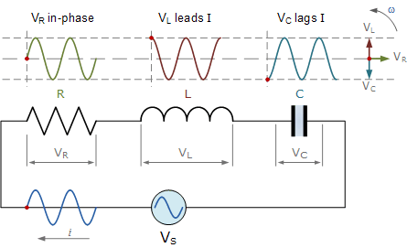
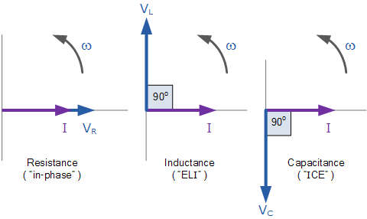



Series RLC Circuit Analysis

Slide 4
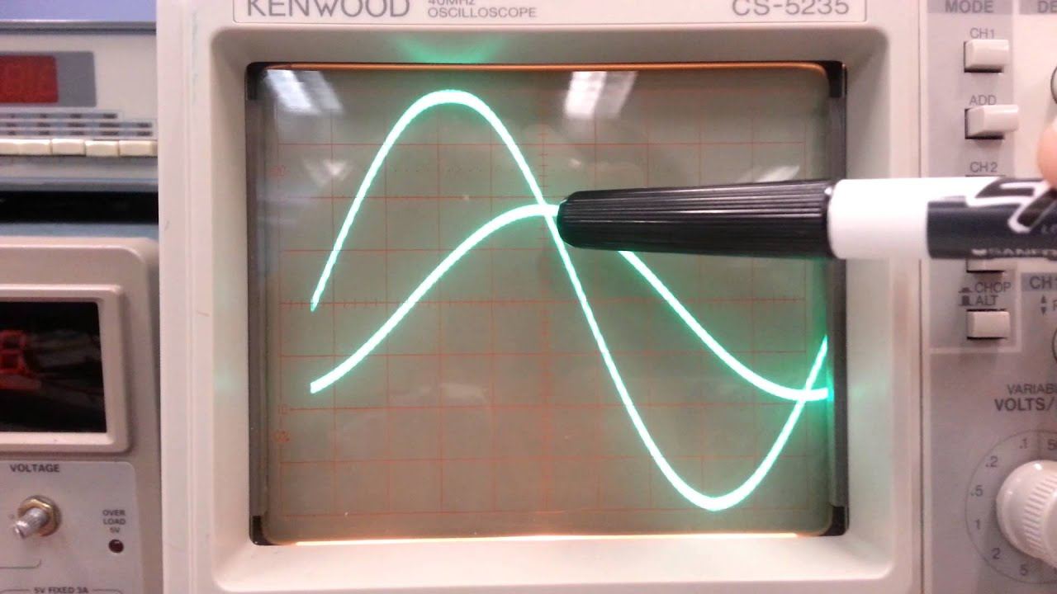

Slide 5


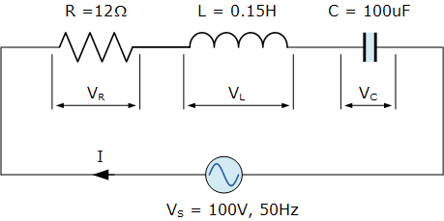
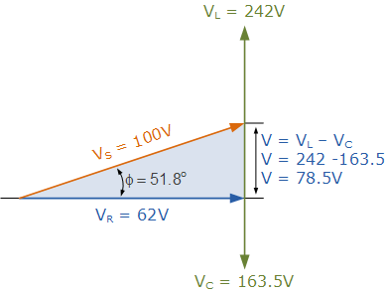






EX1: A series RLC circuit containing a resistance of 12Ω, an inductance of 0.15H and a capacitor of 100uF are connected in series across a 100V, 50Hz supply. Calculate the total circuit impedance, the circuits current, power factor and draw the voltage phasor diagram.

Slide 6
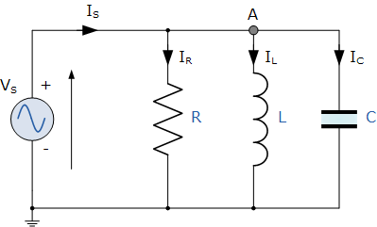
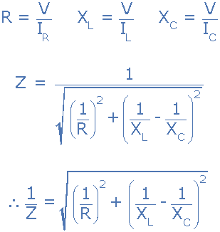


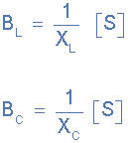
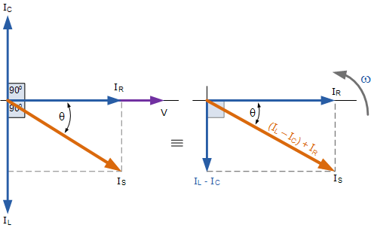
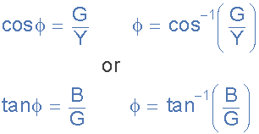
Parallel RLC Circuit Analysis

Slide 7
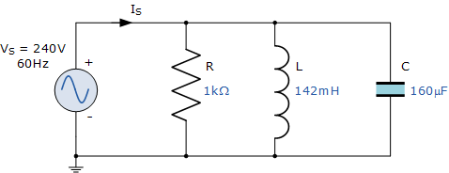
Parallel RLC Circuit Example No1
A 1kΩ resistor, a 142mH coil and a 160uF capacitor are all connected in parallel across a 240V, 60Hz supply. Calculate the impedance of the parallel RLC circuit and the current drawn from the supply.

Slide 8
